Slide 1

CALL CENTRE REPORT – 2023

Slide 2

Project Overview
This project is a comprehensive performance analysis of customer service call data for the year 2023. It integrates two datasets: Calls Table and Customers Table, using Power Query to clean, transform, and model the data for actionable insights. The final deliverable is an interactive Excel Dashboard.

Slide 3




Project Objective
Monitor call center efficiency
Understand customer demographics
Through KPIs like call volume, duration, satisfaction ratings, and purchase behavior.
And how they relate to service quality.
Enable management tracking
To track representative performance, identify high-performing cities, and address service gaps.
This dashboard will empower stakeholders to make data-driven decisions aimed at improving customer satisfaction and operational productivity.

Slide 4
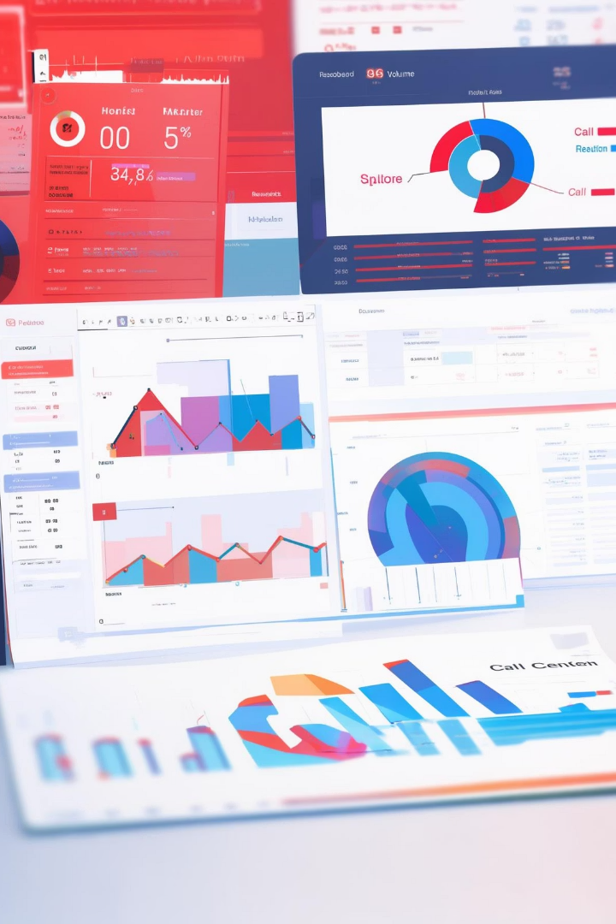



Tasks & Instructions Followed
Data Preparation using Power Query
Cleaned and transformed both Calls Table and Customers Table
Merged datasets to associate customer demographic info with call details
Dashboard Tasks Completed
Built key performance indicators (KPIs): total calls, amount, duration, average rating, happy callers
Plotted call trends across months
Created visual breakdowns
Calls by representative
Purchase amount by representative
Gender and city-wise distribution
Day-of-week call distribution
Rating distribution chart
Call and revenue matrix (customer-rep-wise)

Slide 5
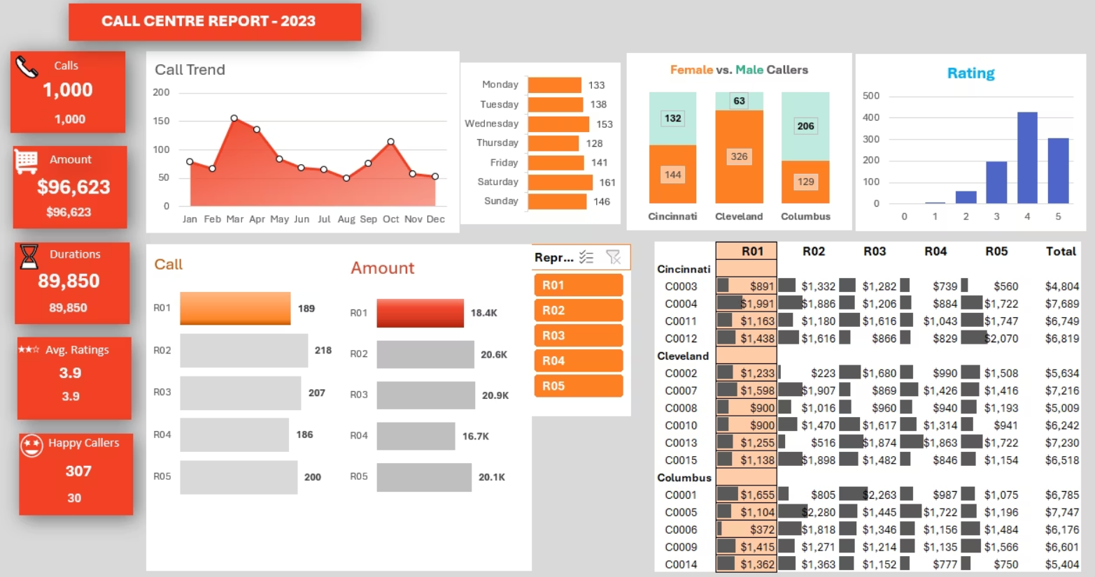
Dashboard

Slide 6

Dashboard Usage Instructions
Use slicers or filters
To view data by representative, city, or customer
Hover over graphs
For detailed tooltips
Refer to the right matrix
For customer-level revenue by representative
Analyze bar graphs
To track rating trends and gender balance by city

Slide 7
Key Insights from the Dashboard
Highest Revenue Representative
Top Performing Day
Top Rated Segment
Saturday recorded the highest call volume (161).
Ratings of 4 and 5 dominate, with over 60% of total responses.
R03 generated the highest amount – $20.9K.
City-wise Gender Imbalance
High-Earning Customers
Cleveland has significantly more female callers (326) compared to males (63).
Customers like C0004 and C0011 contribute notably across multiple representatives.

Slide 8
Strategic Recommendations for Business Growth
Enhance Representative Training
Leverage Top Performers
Optimize Resource Allocation by Day & Time
Focus on improving performance for representatives with below-average satisfaction ratings. Tailored coaching based on individual metrics can raise service quality and consistency.
Representatives like R03 and R05, who contribute the highest revenue and satisfaction scores, can mentor others or handle high-value customer segments.
Since Saturday and Wednesday show higher call volumes, ensure adequate staffing during peak times to reduce wait times and improve service efficiency.
Capitalize on Gender and City Trends
Promote High-Value Customers
Improve Low-Rated Interactions
Identify and prioritize repeat or high-spending customers (e.g., C0004, C0011) with loyalty programs or premium support to enhance retention.
Analyze feedback from calls rated 1 to 3 to identify recurring issues and implement corrective measures.
Cities like Cleveland, with higher engagement from female customers, present an opportunity for targeted marketing campaigns or personalized service approaches.
Use Data to Drive Decision-Making
Regular use of this dashboard can help management quickly spot trends, act on issues, and make informed strategic decisions.

Slide 9








Conclusion
Track Performance
Understand Behavior
Monitor KPIs and representative metrics
Analyze customer trends and preferences
Measure Results
Take Action
Track improvements in service and revenue
Implement targeted improvement strategies
🧠 The Call Centre Report – 2023 reveals key trends and improvement areas in customer service operations.
By utilizing this Power Query-powered dashboard, decision-makers can track performance, understand customer behavior, and take targeted actions to drive growth and customer satisfaction.
Regular monitoring and applying the above strategies can lead to measurable improvements in service quality and revenue generation.

Slide 10



Thank You
Presented by
Dharmesh Parmar
Contact Information
Email: Dhparmar2119@gmail.com
Thank You
For your attention and consideration

